Slide 1
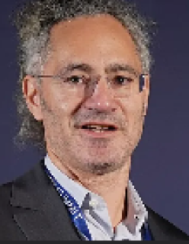

Classification: Threat to human rights 99%
Machine Vision Asthetic
By Cole

Slide 2
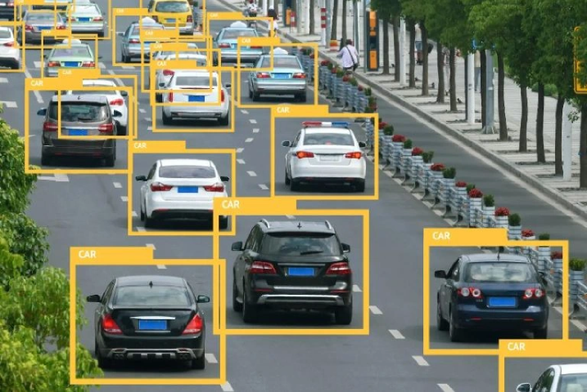
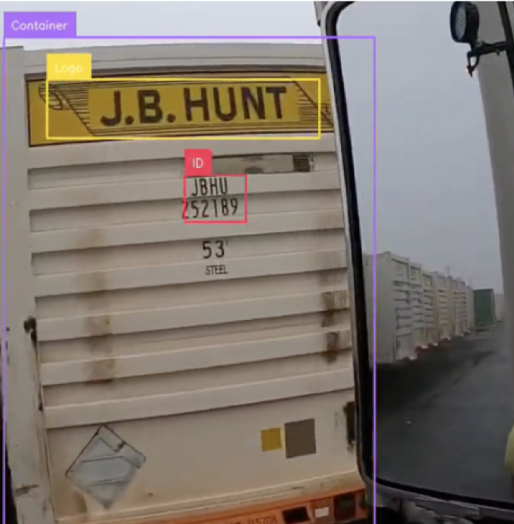
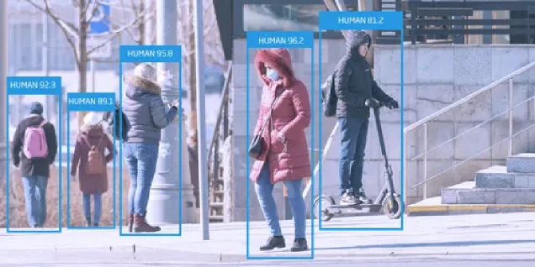
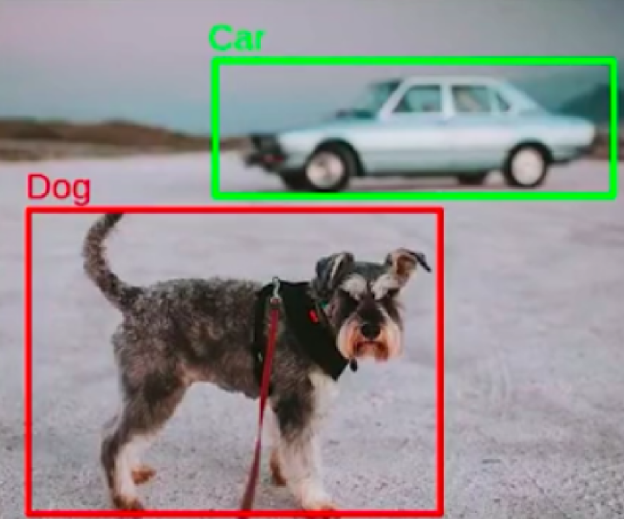
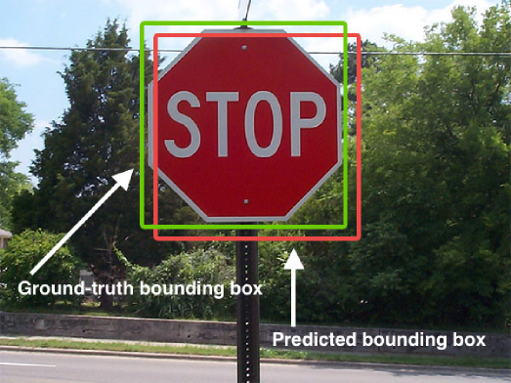
Bounding Boxes & Labels

Slide 3
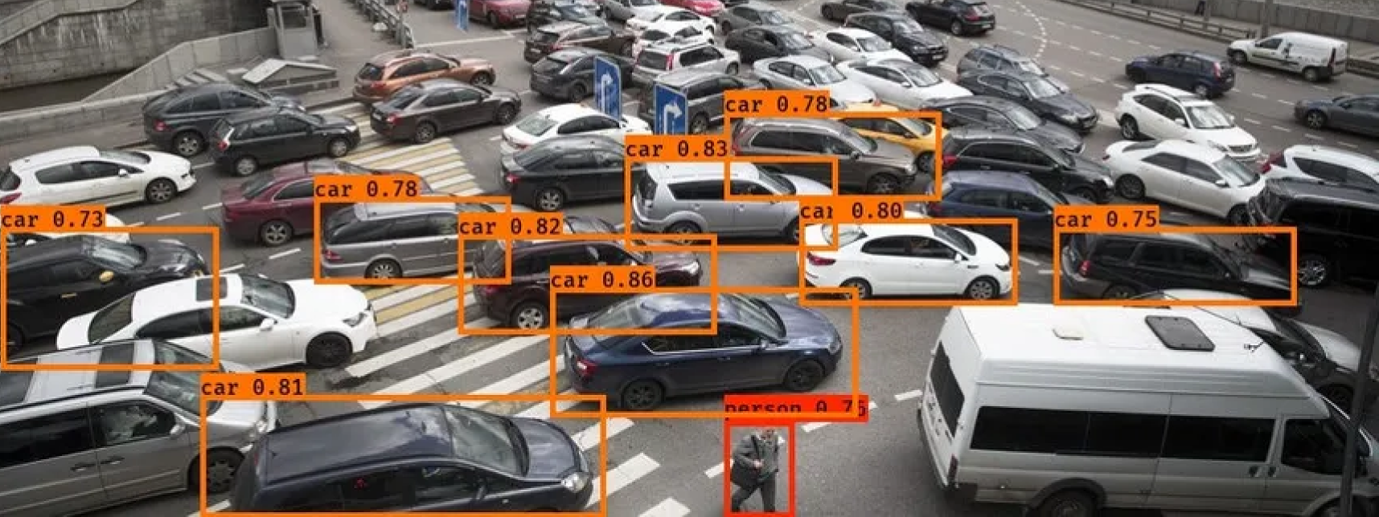
Confidence score

Slide 4
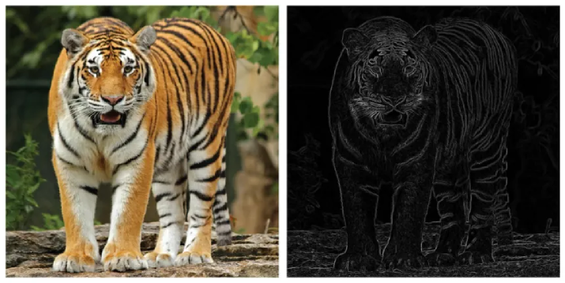
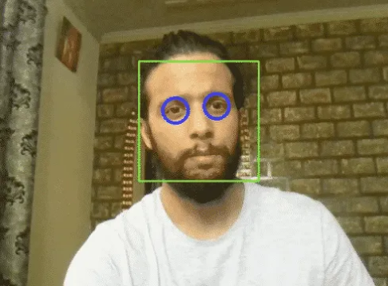
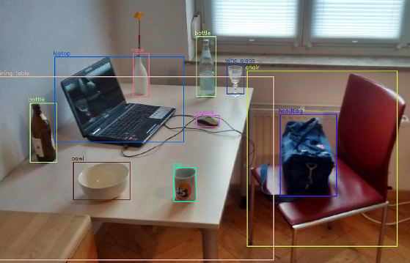
(Brief) History
1960
2001
2015
Edge Detection
Viola-Jones
YOLO & deep learning
This was used in old cameras!

Slide 5
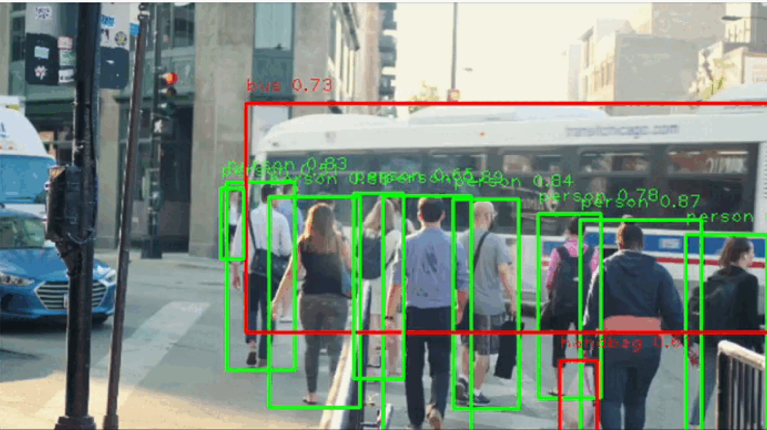
What it looks like in action

Slide 6
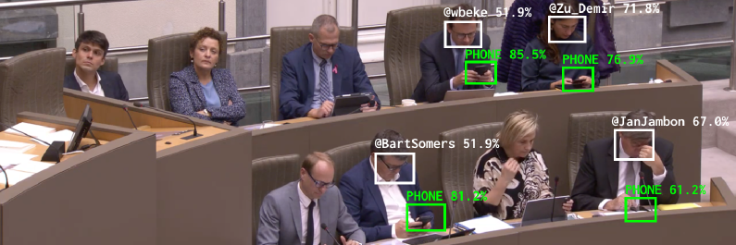
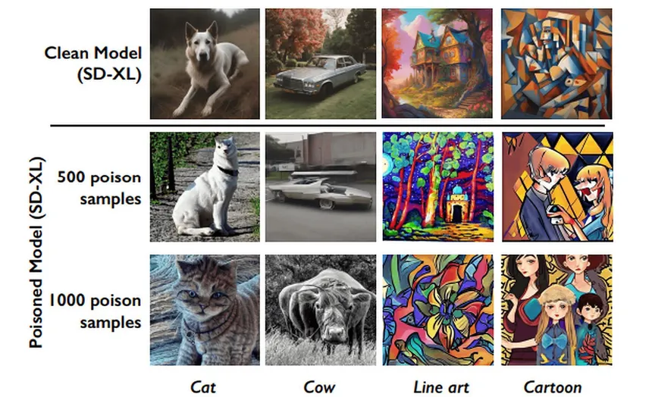
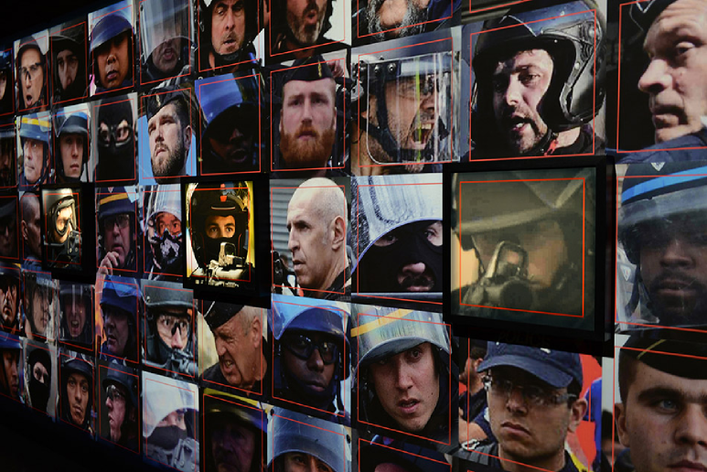
Flipping the script
Flemish Scrollers by Dries Depoorter
Nightshade - Data poisoning tool
Capture by Paolo Cirio

Slide 7
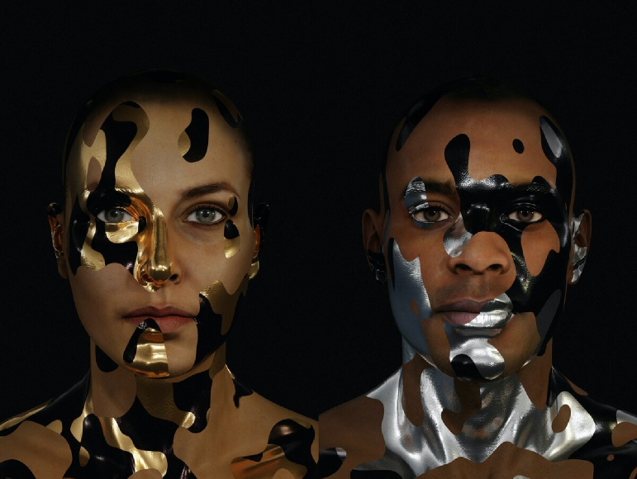
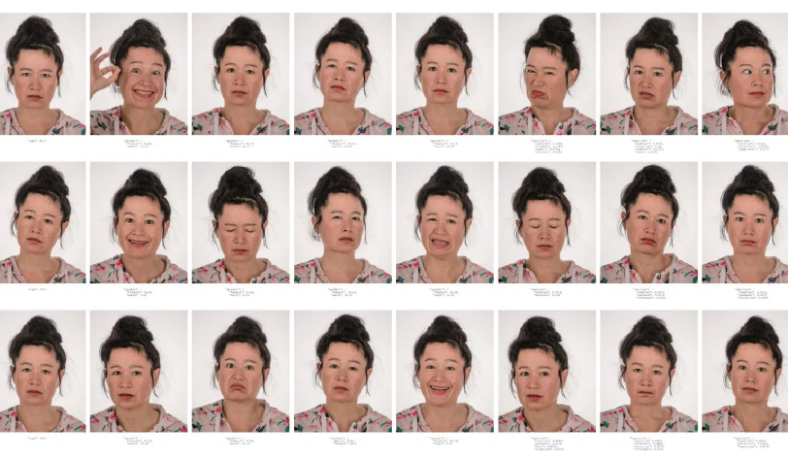
Anti Survellance movement
CV Dazzle - Adam Harvey
Face Paint to break neural nets
Machine Readable Hito

